Slide 1
Stream&File I/O
Lab2

Slide 2
Notepad++
https://notepad-plus-plus.org/downloads/
Choose the edition you desired
Plugins->Plugin Manager->NppFTP->Download
NppFTP->Show NppFTP Window
Settings->Profile Settings
Hostname:140.113.212.154
Connection type: SFTP

Slide 3
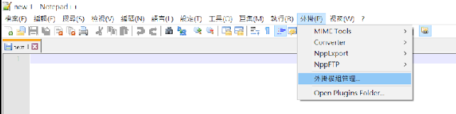
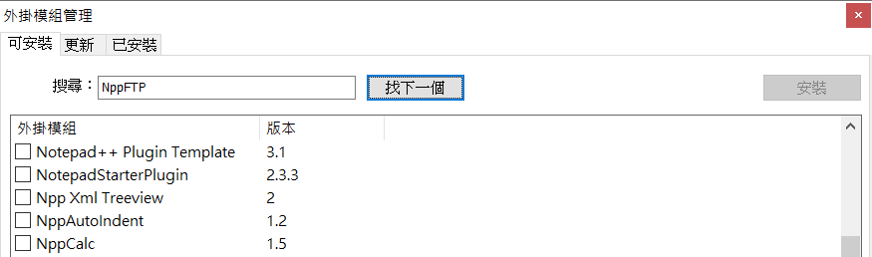
Notepad++
外掛->外掛模組管理->搜尋NppFTP並下載

Slide 4
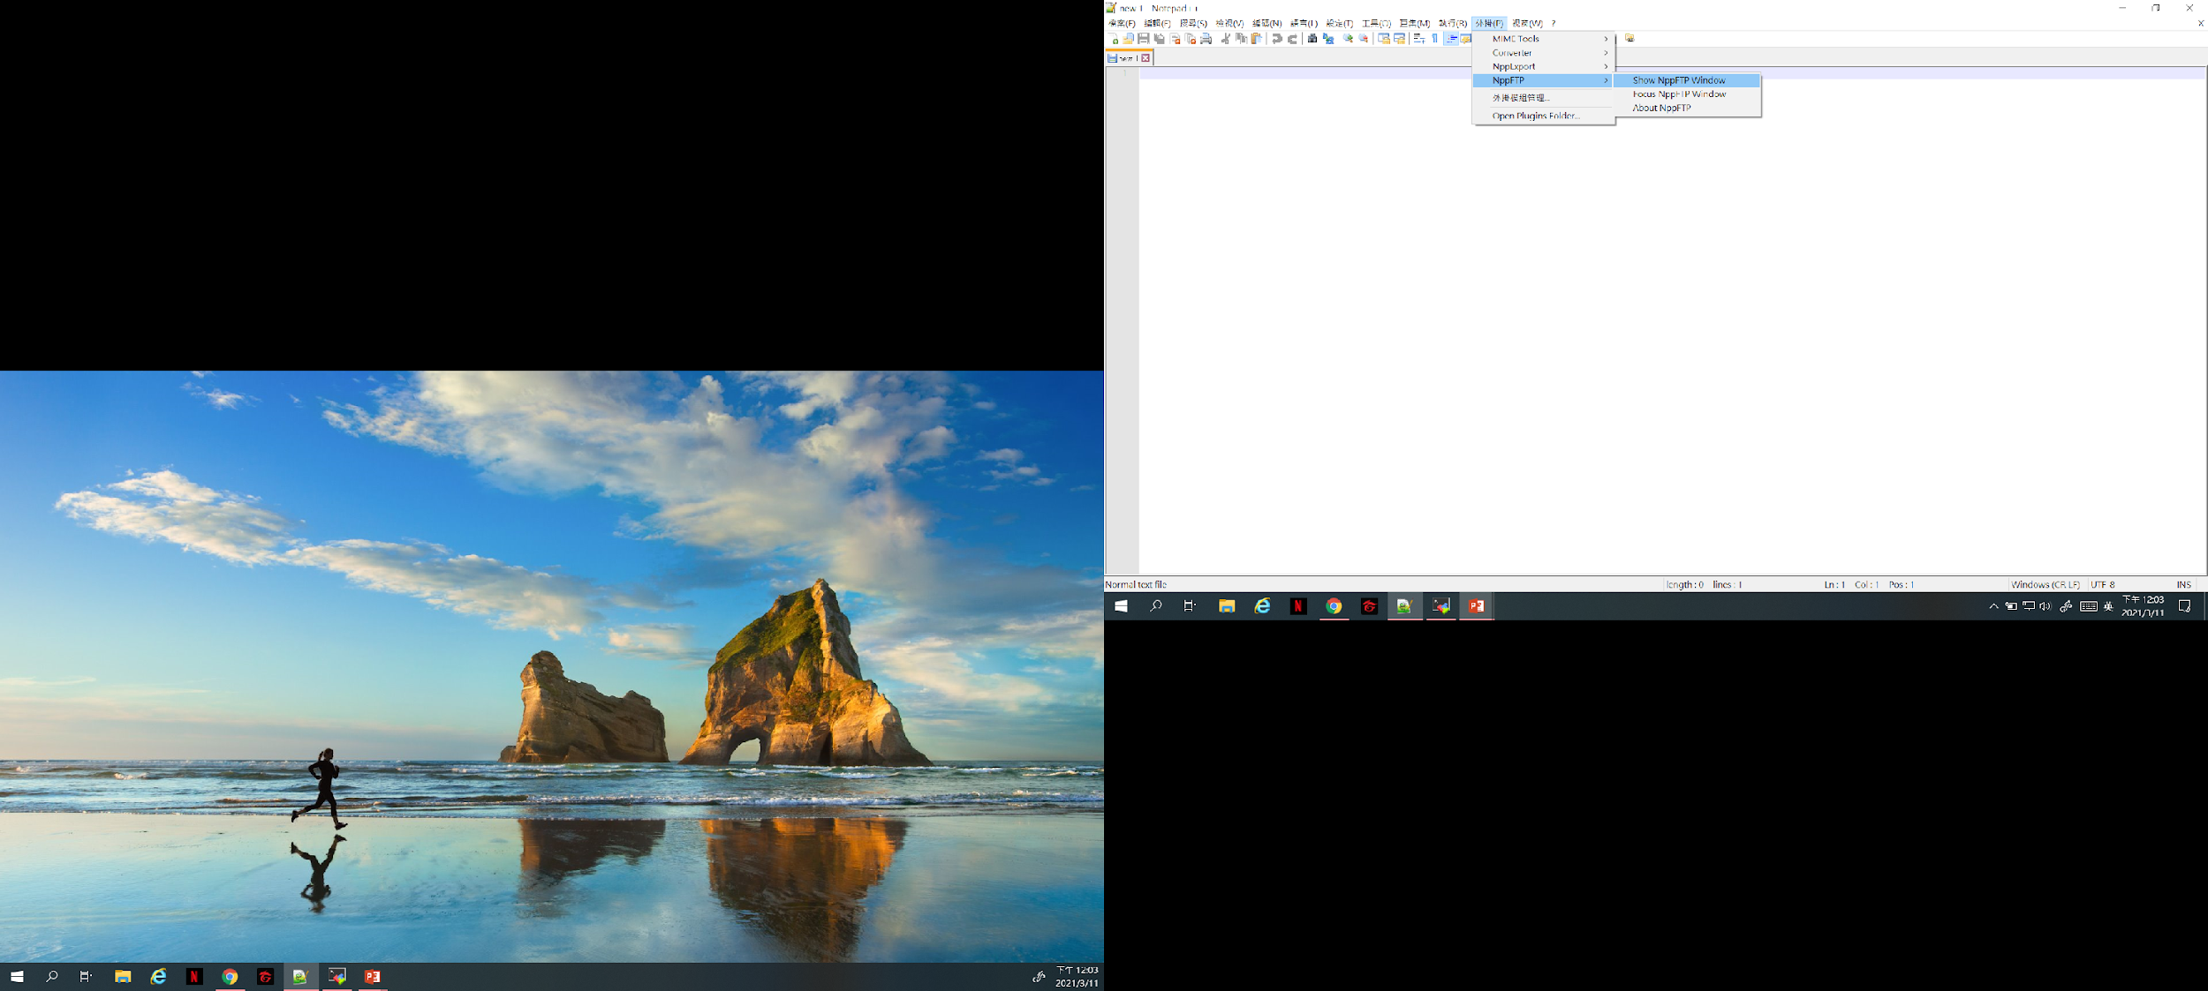
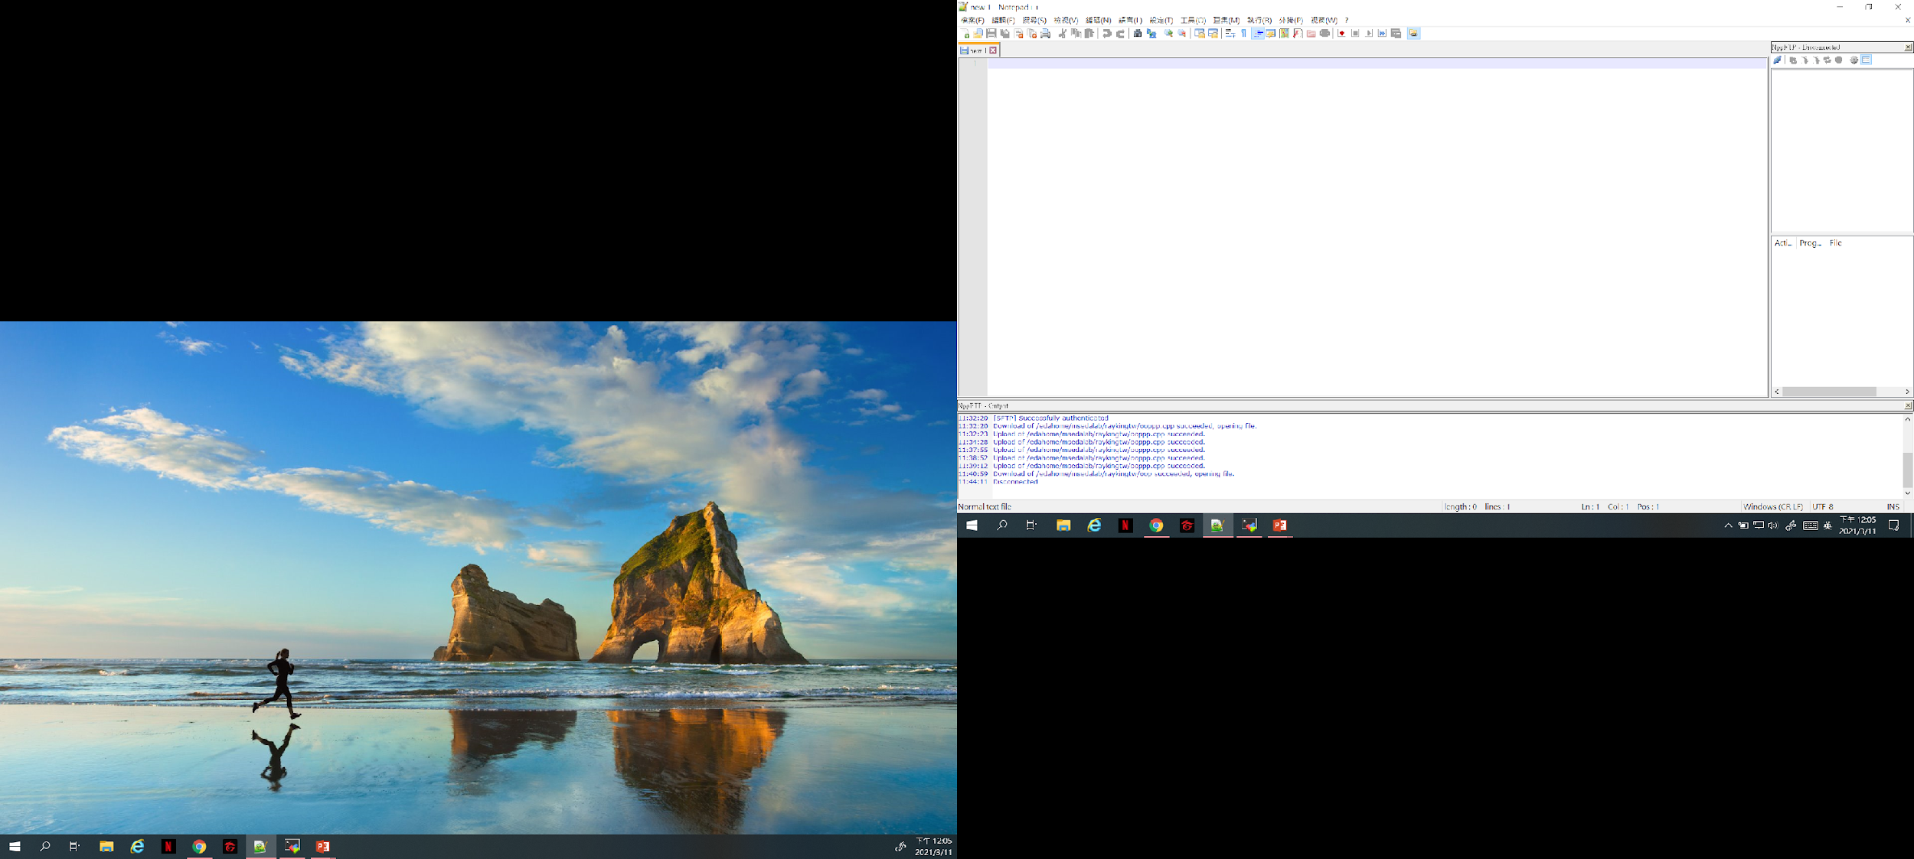
Notepad++
外掛->NppFTP->Show NppFTP Window

Slide 5
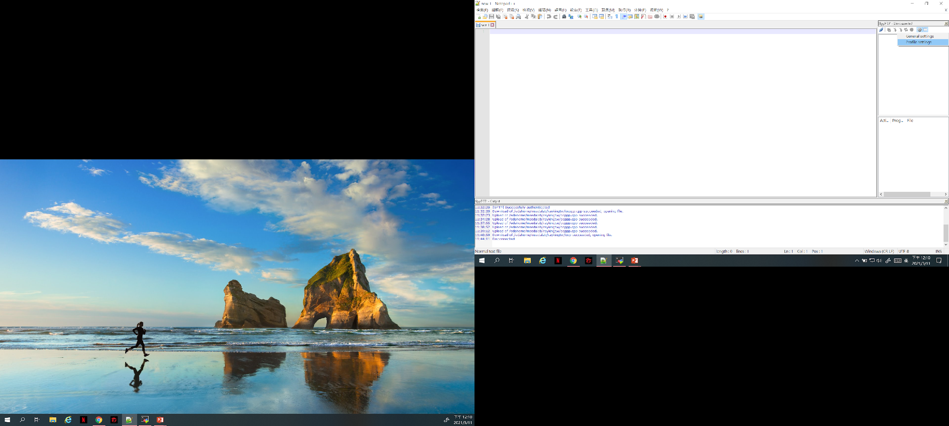
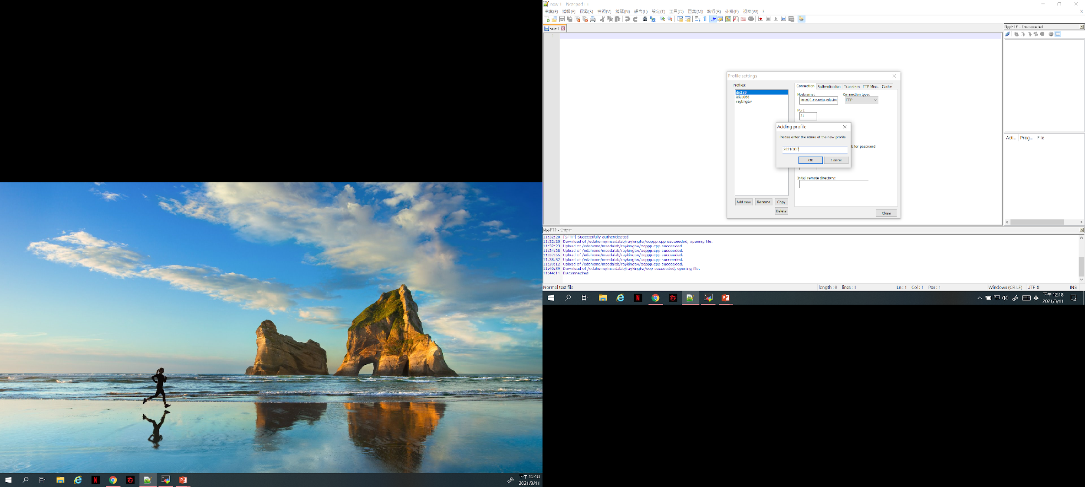
Notepad++
Settings->Profile Settings

Slide 6
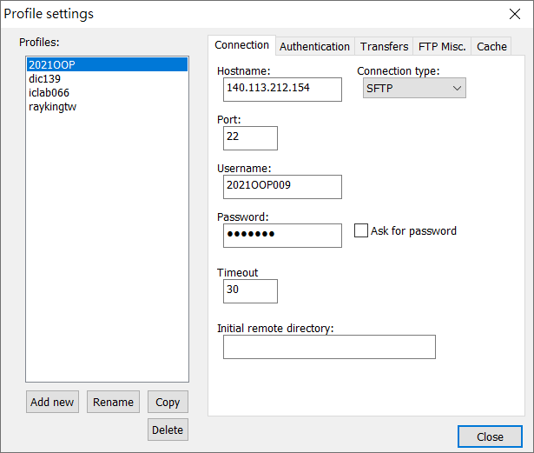
Notepad++

Slide 7
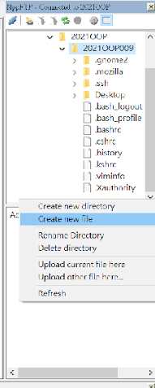
Notepad++
在工作站上開啟cpp檔案，在右邊空白處點右鍵Creat new file

Slide 8
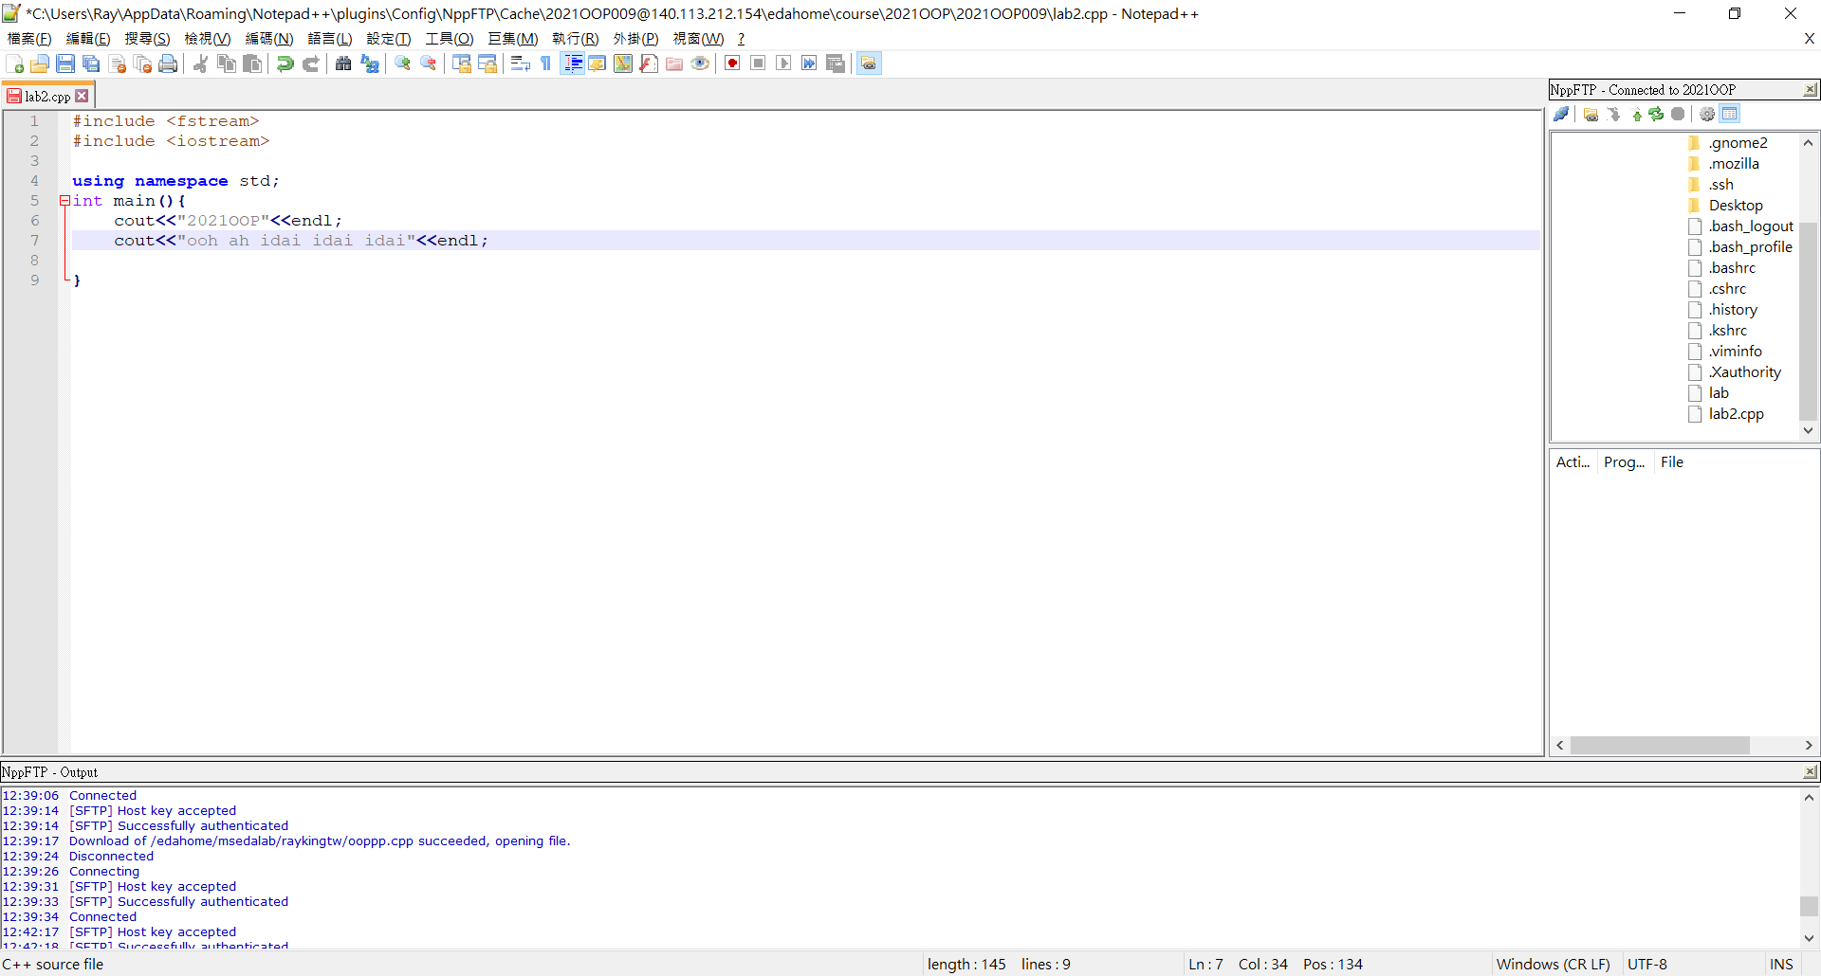
Coding
Coding->Ctrl+s存檔(or左上角存檔)

Slide 9
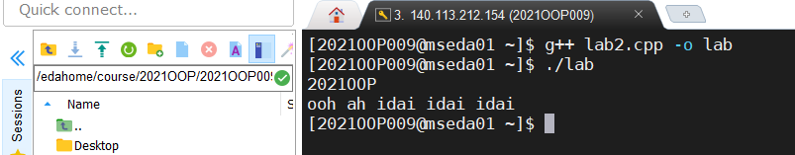
Compile&Run
Compile:
g++ <.cpp檔> -o <執行檔名>
EX: g++ lab2.cpp -o lab
Run:
./<執行檔名>
EX: ./lab

Slide 10
File I/O
Declare a file name variable
#include <fstream>
ifstream input_filename_var ; // input file
ofstream output_filename_var ; // output file
Open the file
input_filename_var.open( “.../file_path/filename” );
output_filename_var.open( “.../file_path/filename” );

Slide 11
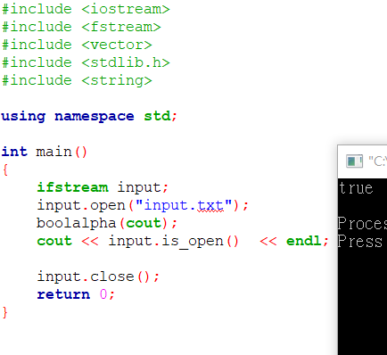
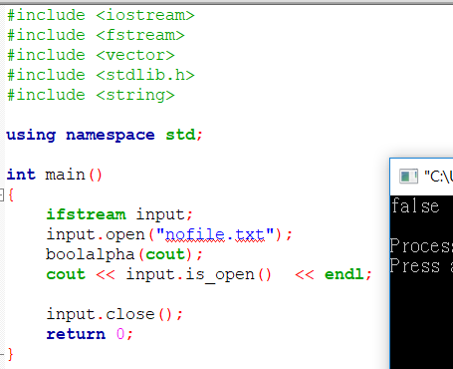
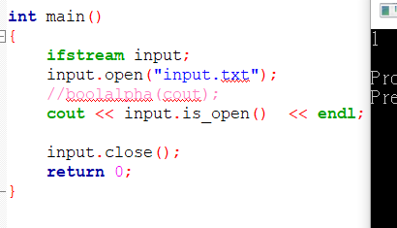
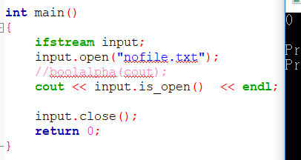
Check file was successfully opened

Slide 12
Use the file (input file)
Input file syntax just like input stream “cin”.
Example:
input_filename_var >> x >> y; // x and y are integers
input_filename_var >> ch; // ch is a char
ch = input_filename_var.get(); // ch is a char
input_filename_var.getline(ch, ch_num); //ch is char*, ch_num is streamsize
getline(input_filename_var, str_var); // str_var is string

Slide 13
Use the file (output file)
Output file syntax just like output stream “cout”.
Example:
output_filename_var << x << y; // x and y are integers
output_filename_var << ch; // ch is a char
output_filename_var << “Hello World!” << endl; // literal string
output_filename_var << str; // str is a char* or string

Slide 14
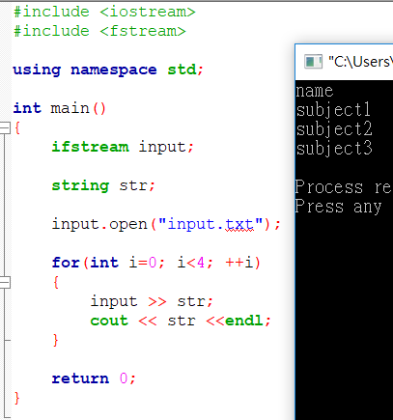
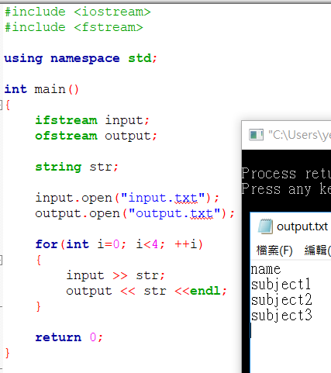
Use the file (output file)
For example,
Using “cout”
Using “ofstream”

Slide 15
Close the file
All files are closed automatically upon termination of program execution.
It is a good habit to close them explicitly.
Also, close them as soon as they are no longer needed by the program.
input_filename_var.close();
output_filename_var.close();

Slide 16
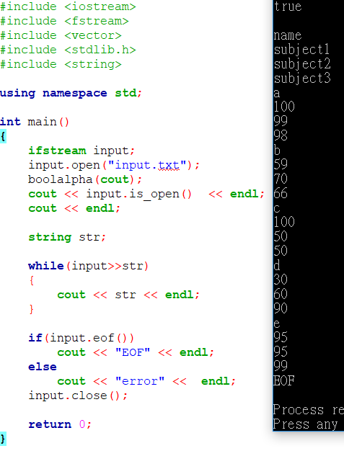
Detect end of file
string a;
while(input >> a) {
…
}
while(!input.eof())
{
input >> a;
…
}

Slide 17
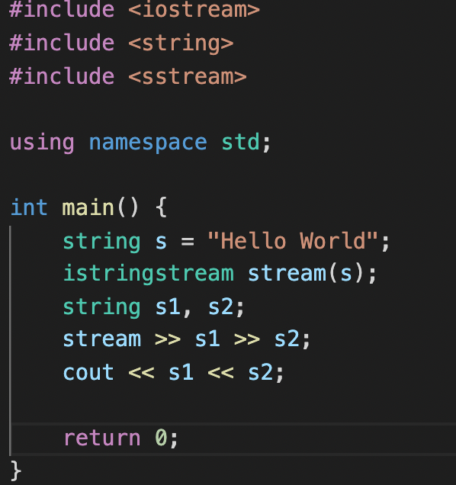
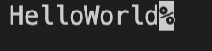
Turn string to stream
#include <sstream>
istringstream stream_name(string)

Slide 18

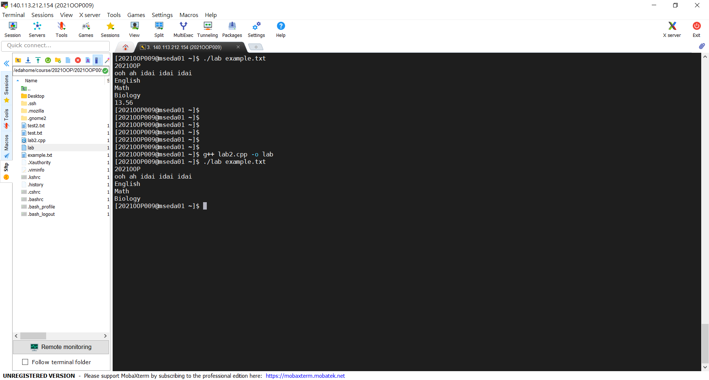
Input file from Mobaxterm
int main(int argc,char **argv){}
ifstream input
input.open(argv[1],ios::in)
argv[1]
argv[0]

Slide 19
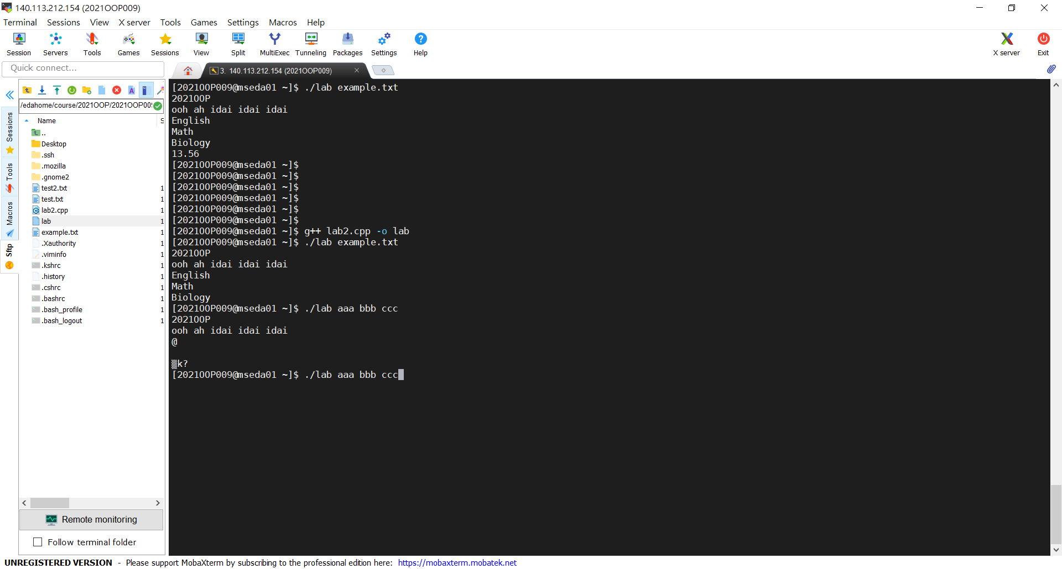

Input file from Mobaxterm
EX:aaa->argv[1]，bbb->argv[2]，ccc->argv[3]
EX:-i->argv[1]，example.txt->argv[2]，and so on
You can decide which input file and output file name you want to use on your own

Slide 20
Exercise
Today you will practice how to read/write the file, and input your file on Mobaxterm.
First, please download input file(bulk_32nm.l) on new e3.
Second, read the xxx file and specify the output file using the following format.
inFile.open(argv[1]);
Third, get the requested data.
Final, generate a “output.txt” file.

Slide 21
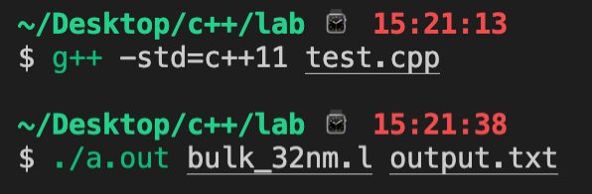
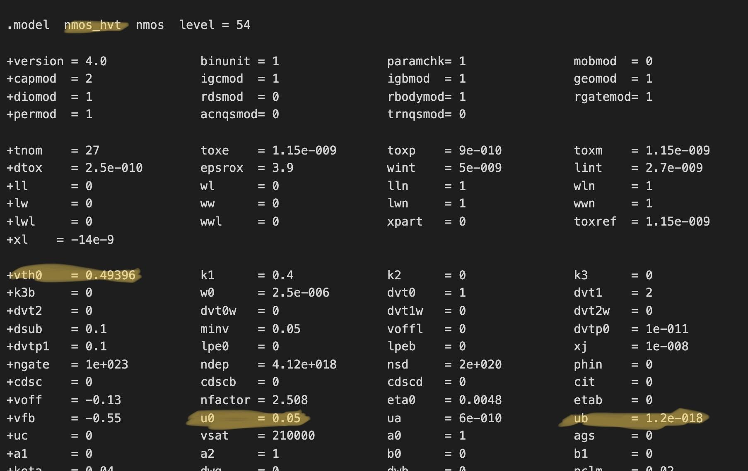
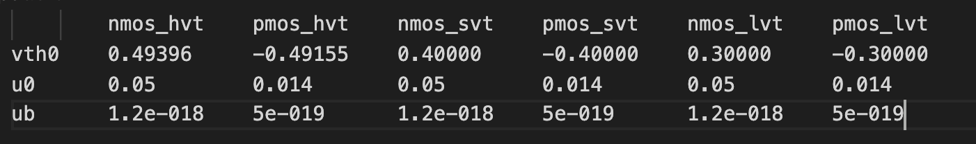
Exercise
bulk_32nm.l
output.txt

Slide 22
Submission
Ask TAs for demo
Try your best to debug your code by yourself
Upload all your cpp to new E3
Naming rule : studentID_lab2.cpp

